Slide 1
Designing a POCKET ORGAN 设计一款口袋乐器
A mobile, chord-based, easy-to-learn instrument.
已和弦为主，易上手的随身乐器。
Thomas TEMPÉ 唐沛
2019-06-22

Slide 2
Desirable attributes 期望特性

Slide 3
Desirable attributes 期望特性

Slide 4
Desirable attributes 期望特性

Slide 5
Desirable attributes 期望特性

Slide 6


Use cases 用例
Target audience: 目标者：
Beginner musicians
Use cases: 用例：
Practice on the go 随时随地锻炼
Play as you sing 边唱边弹
Accompany friends singing 小卷伴奏

Slide 7
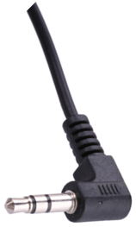
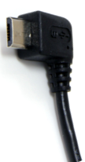
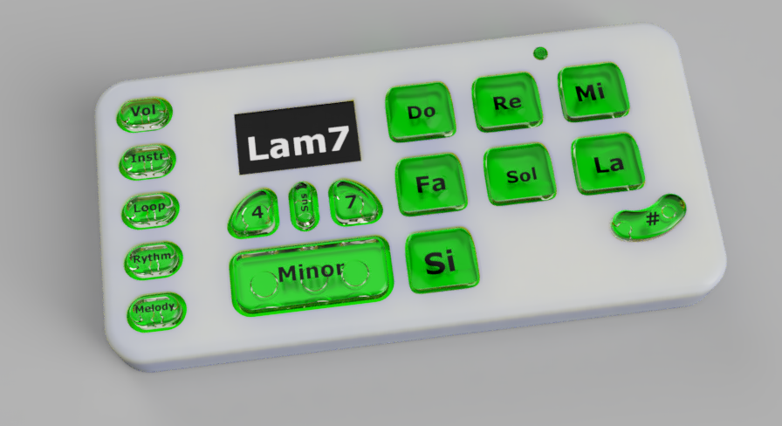
INSTRUMENT LAYOUT 乐器的样子
USB for MIDI & charging
USB充电与MIDI接口
Headphone jack
耳机插座
Display:
Tells you what you’re playing!
屏幕显示您现在在谈什么
Analog keys,
Major chords by default
模拟压力按键
默认是大调
Backlit for loops navigation
背光支持循环点选
Chord variant modes
其它和弦按键

Slide 8
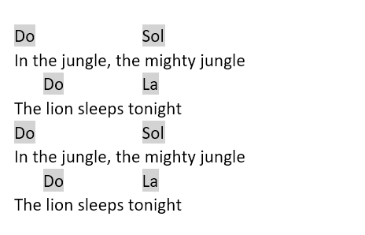
Plays like a guitar (only, easier) 比吉他还容易

Slide 9
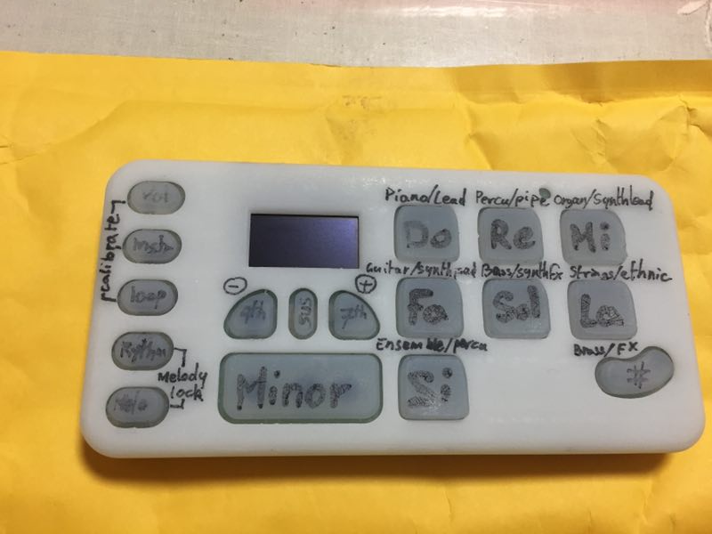
Current prototype 先有的样件
What’s working 已实现
Analog buttons expression 模拟按键与表现力
Chords & melody 和弦与单音模式
Midi synth & battery 合成器与电池
Midi USB
3D-printed enclosure, home-cast silicone keyboard 外壳是3D打印，硅胶键盘用3D打印的模具

Slide 10
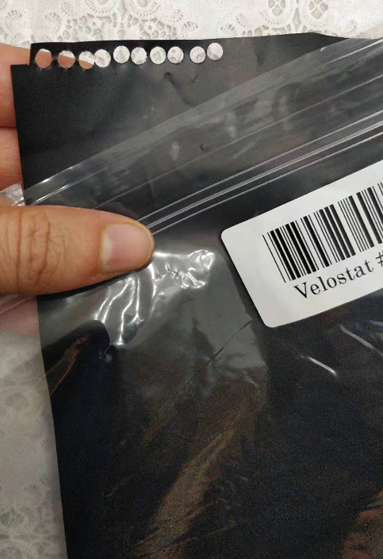
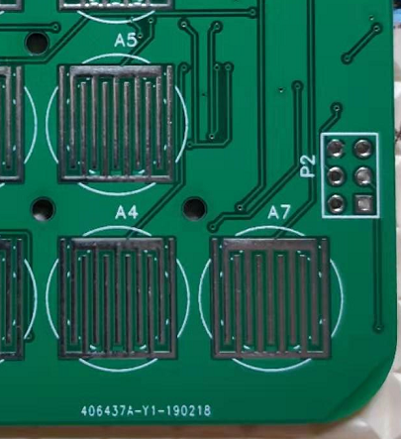
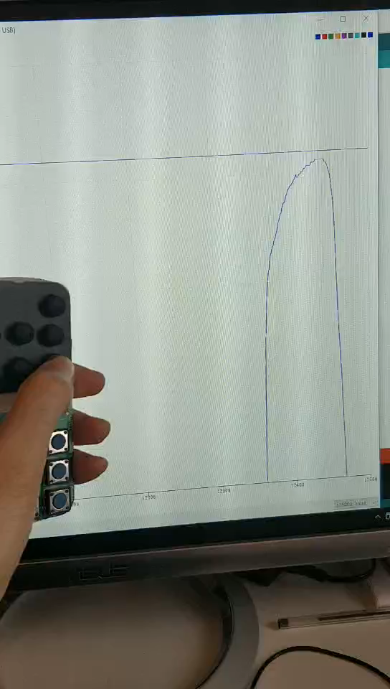
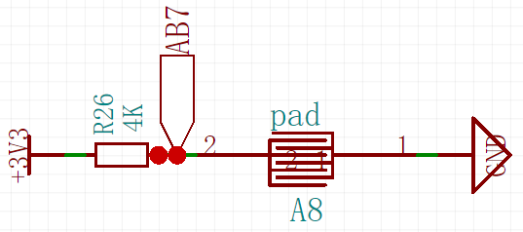
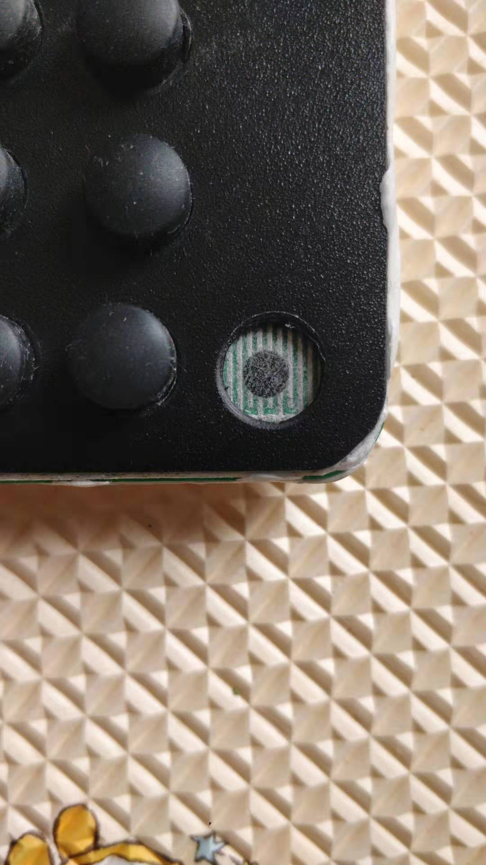
Analog Velostat keys 模拟按键

Slide 11
Thank you 谢谢

